Slide 1
MCU TNC Assignment 1
David Cain, Kobe Keopraseuth, and Kaleb Leon

Slide 2
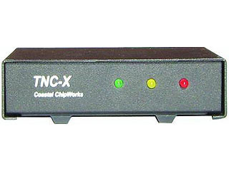
What is a TNC? (Terminal Node Controller)
A device used by amateur radio operators to participate in AX.25 packet radio networks, with the addition of a modem to convert baseband digital signals to audio tones.

Slide 3
How packets are formatted (PC to TNC)

Slide 4
KISS Mode
Packet format from PC to TNC or vice versa. Containing a start and end flag with a payload in the middle. (Assuming those flags will be considered our PTT?)
C0 | PAYLOAD | C0

Slide 5
How packets are formatted (TNC to TNC)

Slide 6

HDLC (High level Data Link Control)
Flags (start and end) – 01111110
Address – AX.25
Control – What is the data? Information, number, unnumbered, or supervisory
Information – Basically your data up to 256 octets(512 bytes)
FCS(aka Parity Bits) – used for error checking, a set of bits defined at the transmission side from the other frames using algorithm. If not the same on the received side packet is discarded.

Slide 7
AX.25 Protocol
Specifies that the address field of the HDLC frame be split into multiple addresses:
Source Address
Zero or more repeater addresses
Destination Address
Addresses correspond to stations call signs

Slide 8
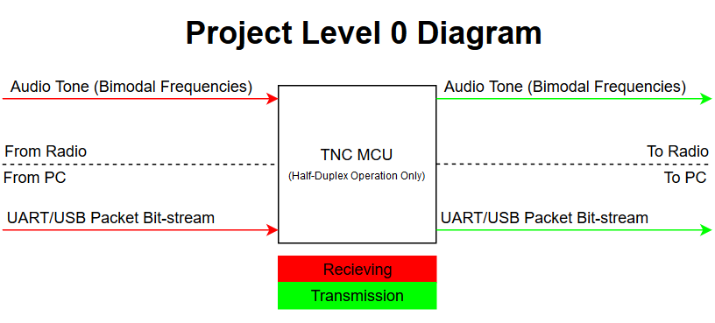

Slide 9
Scope of Work

Slide 10
System Basic Functionality
Receiving
Receive Audio Tone Signal
Analog to digital convert into binary
Gather payload
Check for Errors
Send payload via KISS to PC
Transmitting
Receive KISS formatted data from PC
Follow AX.25 protocol to form data packet
Translate into analog audio tone signal
Send Audio tone to radio

Slide 11
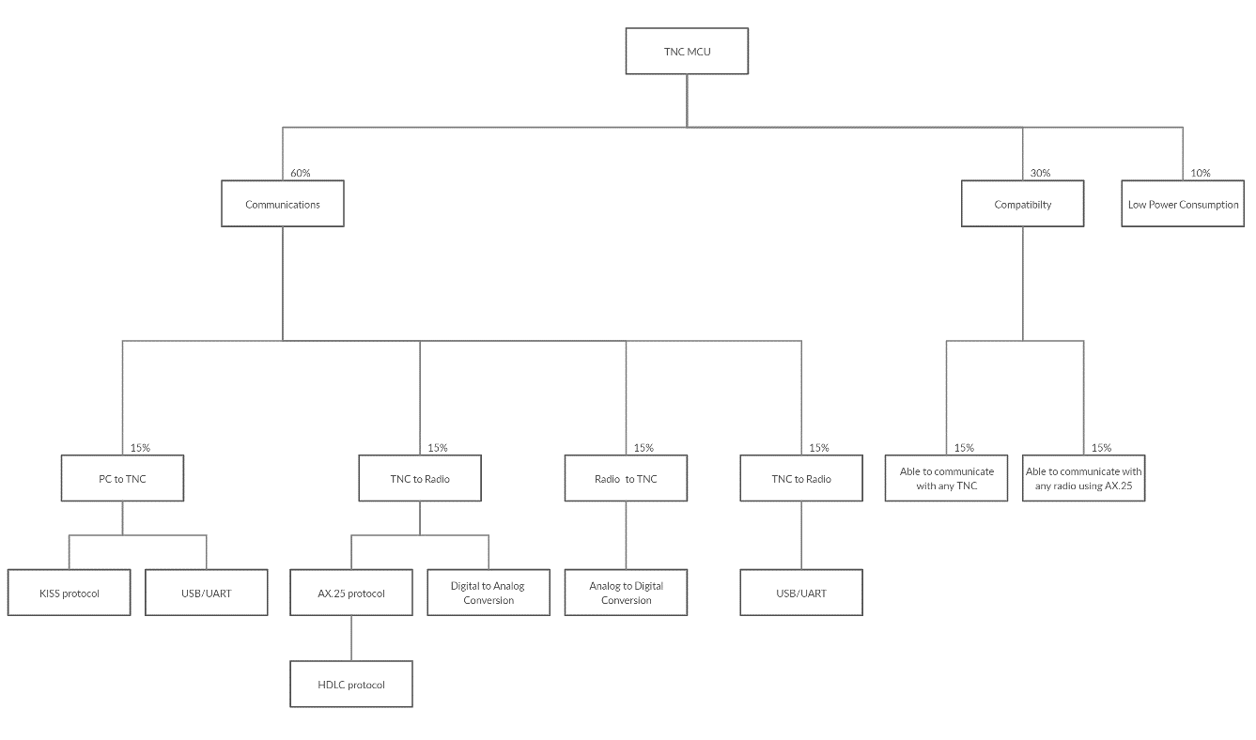
Objective Tree
TNC to PC

Slide 12
Specs

Slide 13
Category | Requirements
Power | 3.3 VDC to 5.5 VDC 10 mA
Environmental | -30 to 70 deg C <2x2 Inches
Audio Input | 50 mV into 1K ohms BER 10-3 @ 6db snr
Audio Output | 400 mV into 1K ohms
Protocol | KISS Mode AX.25 HDLC
Digital Input | 3 Volt UART
Digital Output | 3 Volt UART
LED Indicators | PTT indicator RX good Packet Energy in Audio Passband
PTT (Push to Talk) | Active High & Low Supply and Sink 20 mA Accept 3 to 15 Volts

Slide 14
Alternatives and Tradeoffs

Slide 15
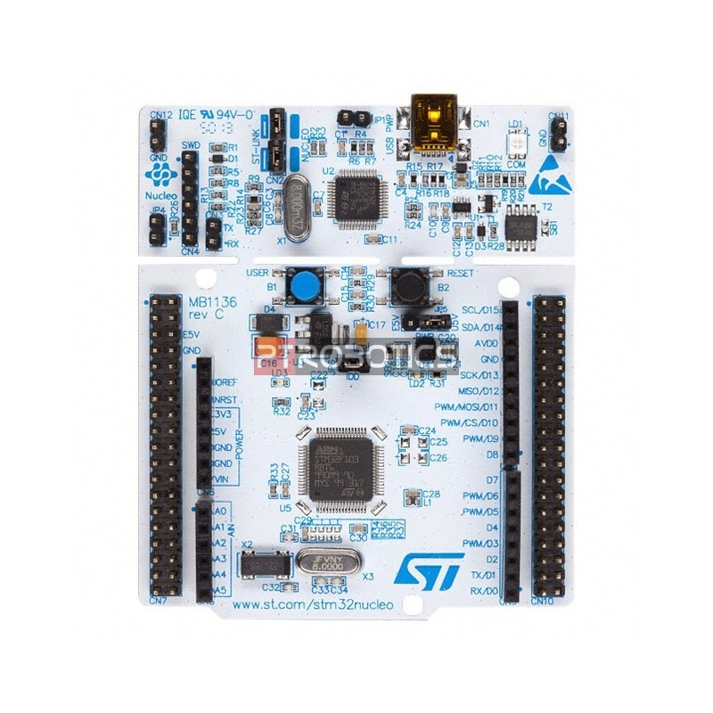
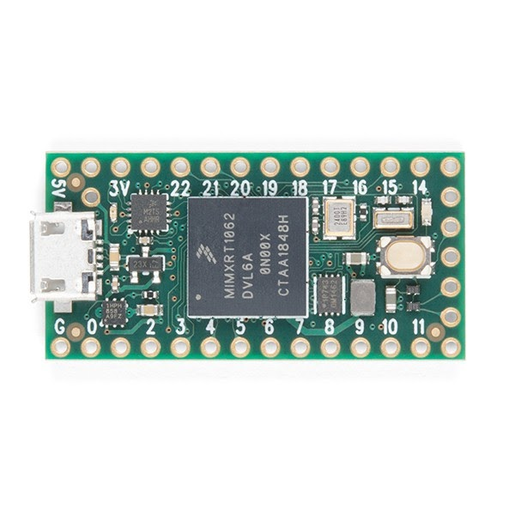
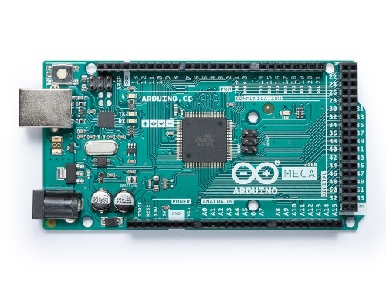
MICROCONTROLLER | STM32L4433 | Teensey 4.0 | Arduino Mega
Description | This microcontroller contains 16 external ADC channels, 1 12-bit ADC, 2 12-bit DAC output channels, an on board RTC, 2 CAN buses, 2 ultra-low-power comparators, CRC calculation unit, and a Schmitt trigger I/O. | This microcontroller contains 40 digital pins (all interrupt capable), 14 analog pins, 2 ADCs on chip, a RTC for date/time, an ARM Cortex-M7 at 600 MHz, 1024K RAM (512K is tightly coupled), and a 2048K Flash (64K reserved for recovery & EEPROM emulation). | This microcontroller contains 16 Analog read pins, 53 Digital pins, and 6 interrupt pins.
Cost | 14.90 | 19.99 | 18.99
Pros | Contains CRC calculation unit Low Cost Many GPIOs | Fast clock speed Has RTC | Easy to use Many GPIOs
Cons | Embedded C programming | Highest Cost No CRC calculation unit | Does not contain RTC Does not contain DACs or ADCs

Slide 16
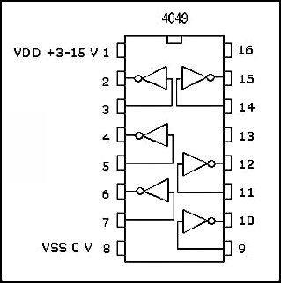
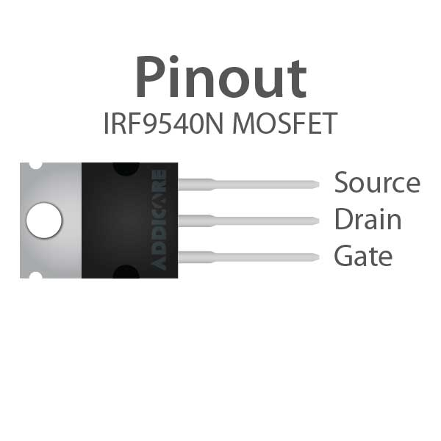
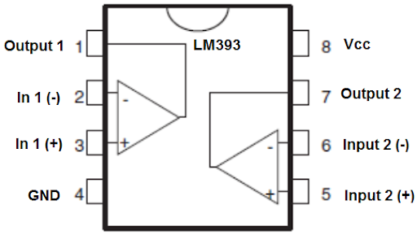
Circuit Design | Inverter Circuit | P-Channel MOSFET | Comparator IC
Description | This IC outputs an inverted signal of the input. | Simple transistor gate to create the desired active low needed for radio circuits. | Many of these ICs feature several outputs: A<B, A>B and A=B. Using the greater than output, this would be an easy way to generate an inverting signal.
Cost | Since the device has built in digital logic, this means setting up a circuit for it to operate in would be much simpler than the MOSFET. | Using a MOSFET allows for flexible input voltage and does not add to power constraints. | Since the device has built in digital logic, this means setting up a circuit for it to operate in would be much simpler than the MOSFET.
Pros | Device may not be capable of supplying needed current for the system. Device should be capable of passing ~20mA | MOSFETs can generate excess heat that may cause issues when design is compressed to <2x2in | Device may not be capable of supplying needed current for the system. Device should be capable of passing ~20mA
Cons | This IC outputs an inverted signal of the input. | Simple transistor gate to create the desired active low needed for radio circuits. | Many of these ICs feature several outputs: A<B, A>B and A=B. Using the greater than output, this would be an easy way to generate an inverting signal.

Slide 17
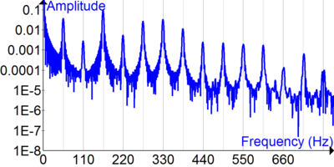
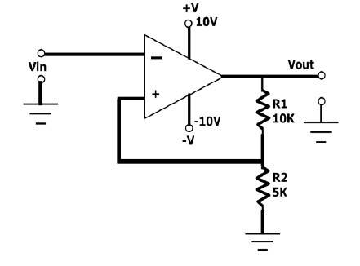
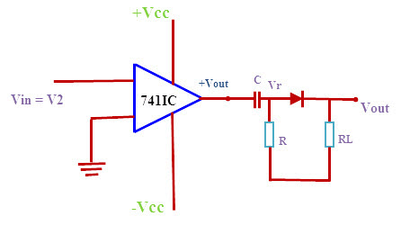
Signal Analysis Method | Fourier Analysis | Schmitt trigger | Zero Crossing
Description | In our case, this project would use this method to add multiple analog signals of different frequencies to generate digital signals | Simple transistor gate to create the desired active low needed for radio circuits. | Uses comparator to output a toggling logic signal when analog voltage goes to zero.
Cost | It doesn’t involve any hardware. | Built in on STM 32 boards, great for filtering out oscillation in digital signal, when noise is in audio/analog signa | Easy implementation with a comparator
Pros | Not efficient because we would need multiple waves of different frequencies to generate a digital signal when we are only working with two different frequencies | If not built on microcontroller we would have to buy a comparator IC | Device may not be capable of supplying needed current for the system. Device should be capable of passing ~20mA
Cons | In our case, this project would use this method to add multiple analog signals of different frequencies to generate digital signals | Simple transistor gate to create the desired active low needed for radio circuits. | Uses comparator to output a toggling logic signal when analog voltage goes to zero.

Slide 18
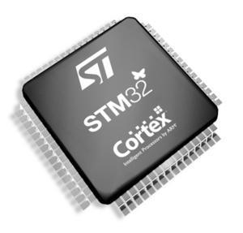
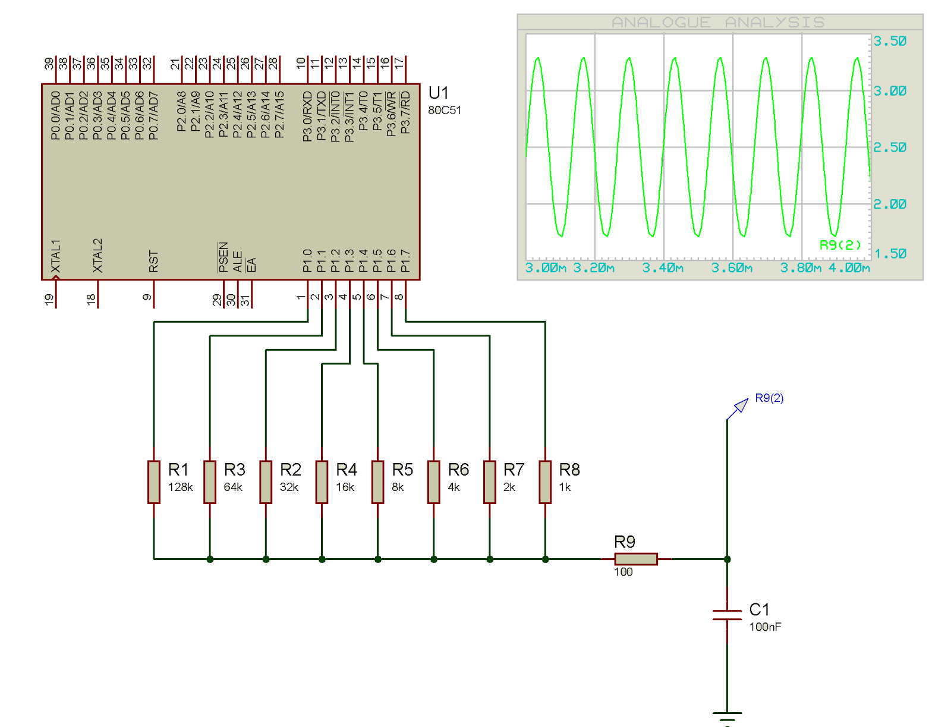
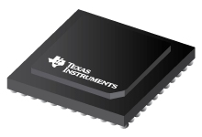
Circuit Design | Built into Controller | Resistor Switching Network | DAC IC
Description | If the design were to include any of the STM32 line, the MCUs have builts in DACs. | Would only consist of using ~4-6 GPIO, connected to different resistor values to represent variable step voltage output. This output would be passed through an LPF to generate a smooth sinusoid. | This would be using a dedicated High-Speed DAC ICs (such as DAC38RF82) that only requires digital input translated to an analog wave for us.
Cost | Similarly to the dedicated IC, the benefit is there will only be a need to generate digital values. | to this option is the simplicity and lack of components needed to generate waveform at low power cost. | is the ease of use, only needing to generate digital values that will quickly be converted to sinusoidal waveform.
Pros | Often built in DACs are slow and this may not work within the strict timing constraints of AX.25 | would be the requirement to create code to drive a resistor network meaning more time would be spent on the DAC | With the dedicated silicon, this will raise the price and power consumption of the board.
Cons | If the design were to include any of the STM32 line, the MCUs have builts in DACs. | Would only consist of using ~4-6 GPIO, connected to different resistor values to represent variable step voltage output. This output would be passed through an LPF to generate a smooth sinusoid. | This would be using a dedicated High-Speed DAC ICs (such as DAC38RF82) that only requires digital input translated to an analog wave for us.

Slide 19
Feasibility

Slide 20
Technological Analysis
The hardware for the project has only a few requirements:
Interface with a terminal program via UART/USB
Packetize data into AX.25 Protocol requirements
Detect the frequency of an incoming audio signal
Output an audio signal representing the packet bitstream
Or output the packet bitstream via UART/USB
With the goal of the project aiming to replace hardware that was originally developed in the early 1980s, this means the technical requirements are minimal.
Tasks such as interfacing with UART or detecting the frequency of an audio signal not only have many options but also are very well documented.

Slide 21
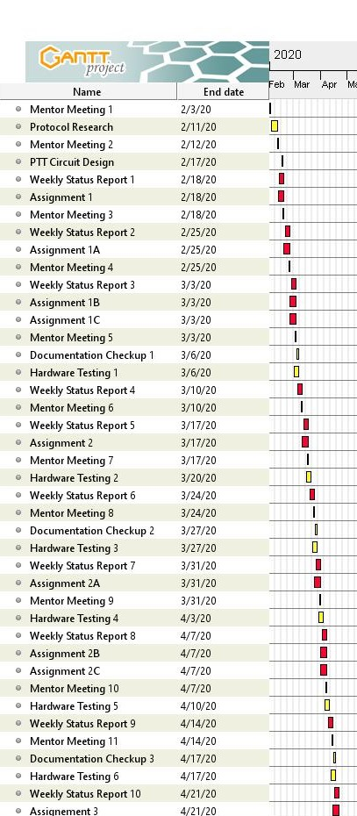
Time Analysis
Gant Chart for Semester 1
The physical designing and testing will begin after a month of research
A goal of our project is to ensure documentation is enough for future groups to have a strong understanding of our system
To ensure this outcome, every three weeks we will dedicate time to ensuring the documentation current at that time is thorough and informative.

Slide 22
Cost Analysis
Item | Rented/Posses | Cost
STM32F446RE Nucleo board | No | $14.90
Arduino Uno | Yes | $0.00
LEDs | Yes | $0.00
MOSFET | No | $2.95
Resistors(22 kΩ, 4.7 kΩ, 470 Ω) | Yes | $0.00
Capacitor (100 nF) | Yes | $0.00
USB logic analyzer | Yes | $0.00
breadboard | Yes | $0.00
3.5 mm/2.5 mm jack | Yes | $2.09/$2.99
jumper wires(M-M, M-F,F-F) | Yes | $0.00
RS232 Cable | No | 2 X ($4.29)
Total: |  | $31.51
This table displays our list of components, along with their prices, and if we currently possess them.
We possess most of the components personally and from our mentors, so the total cost of this project will be under $100, which is very feasible for our circumstances.

